Slide 1

Facial keypoint Detector
Laplacian enhanced FKs detector
Mattia Capparella - 1746513
Federico Fontana - 1744946
Course: Biometric Systems, 2020/2021
Instructor: Maria de Marsico

Slide 2
Overview
Introduction
PyTorch & OpenCV
Dataset Analysis
Keggle solution
Our solution

Slide 3
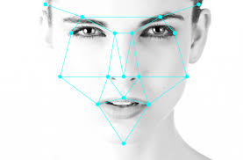
gOAL
Create a custom module for the Facial Feature Detection task
Outperform the implementation found on Keggle
Design a Live Feature Detector
Integration of premade face detector with our solution

Slide 4
FACE RECOGNITION ARCHITECTURE
OVERVIEW
FOCUS ON «FACIAL FEATURE DETECTION 4 FEATURE EXTRACTION»

Slide 5
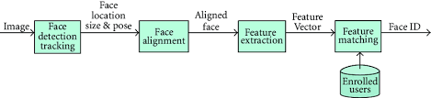
FACE RECOGNITION ARCHITECTURE

Slide 6
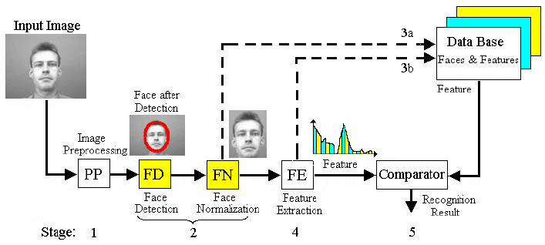

FACE RECOGNITION ARCHITECTURE

Slide 7
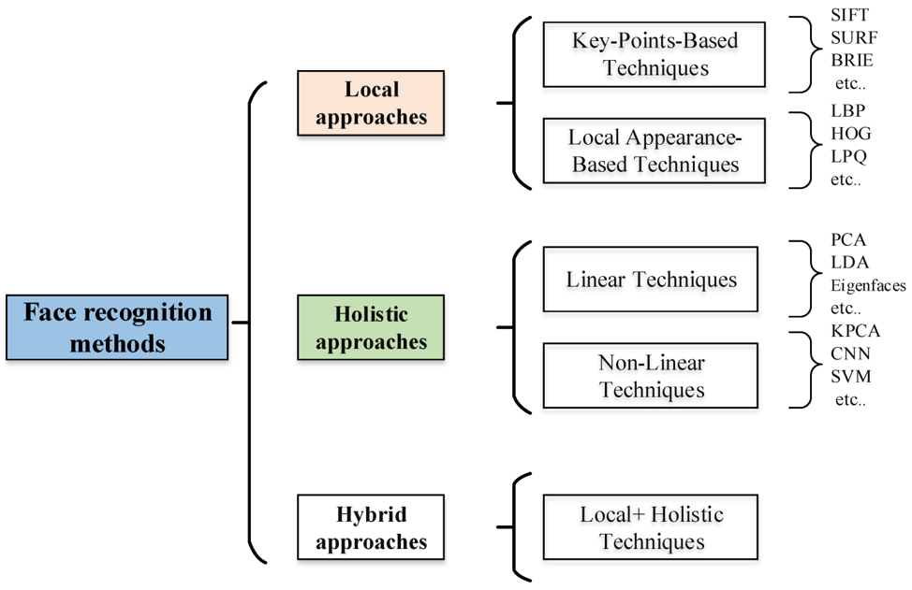
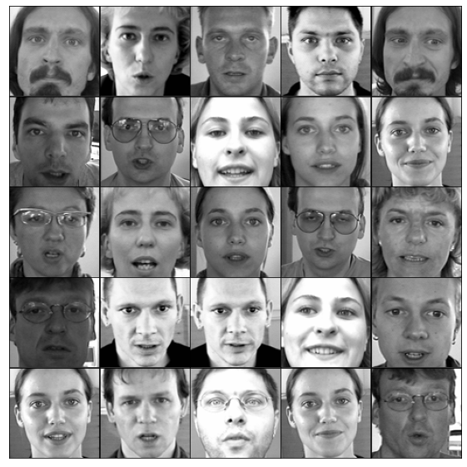
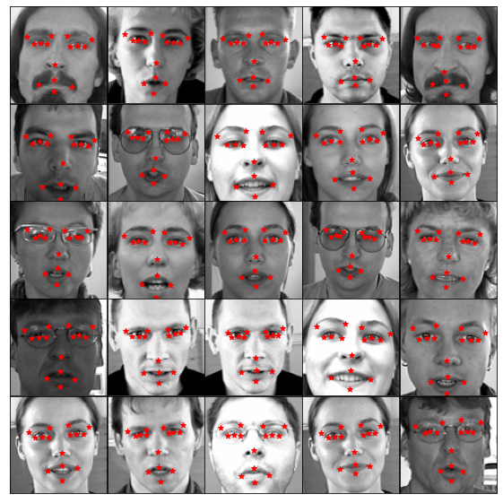
FACIAL FEATURE DETECTION

Slide 8
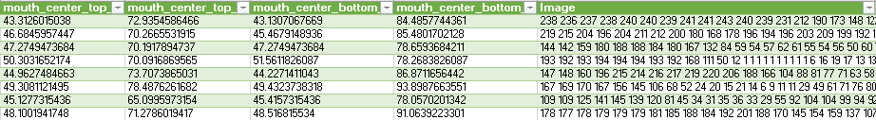
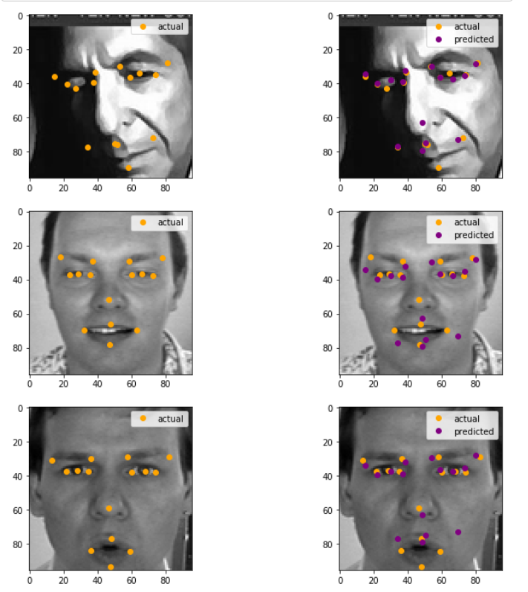
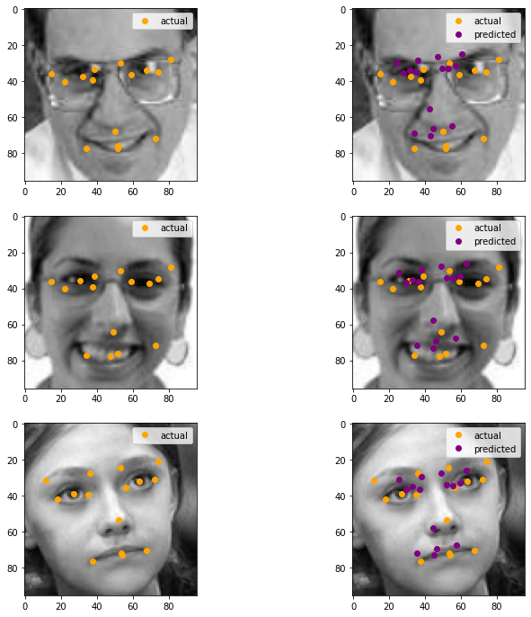
DATASET ANALYSIS
DATA:
IMAGES:
7049 labelled train images
15 keypoints
1783 unlabelled test images

Slide 9
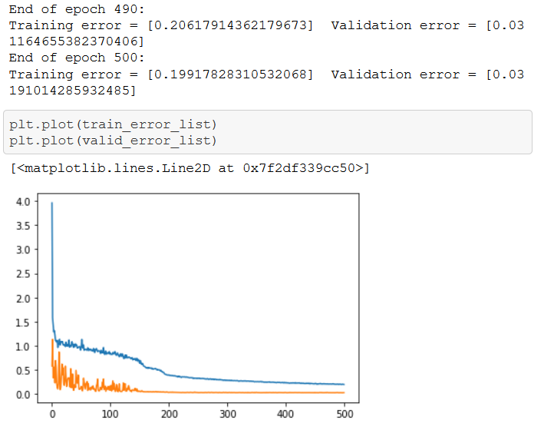
KEGGLE SOLUTION
Data acquisition
Missing Values imputation
Train/Test data preparation
Model selection
Train phase

Slide 10
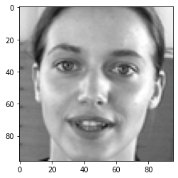
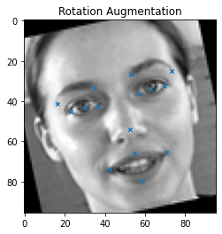
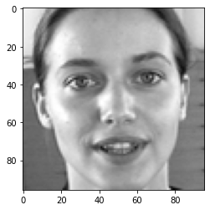
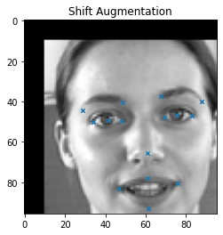
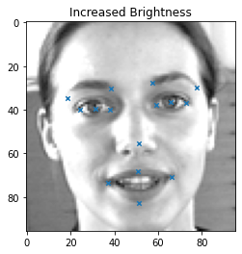
OUR SOLUTION
Flipping Augmentation
Data acquisition
Missing Values Imputing
Train/Test data preparation
Model Selection
Train Phase
Data Augmentation
Edge Localization

Slide 11
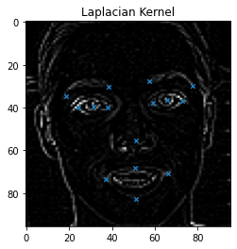
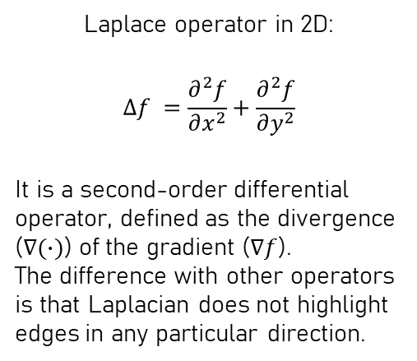
OUR SOLUTION
Data acquisition
Missing Values Imputing
Train/Test data preparation
Model Selection
Train Phase
Data Augmentation
Edge Localization
Laplace operator in 2D:
$$Δf =\frac{∂^{2}f}{∂x^{2}}+\frac{∂^{2}f}{∂y^{2}}$$
It is a second-order differential operator, defined as the divergence ($∇(∙)$) of the gradient ($∇f$).
The difference with other operators is that Laplacian does not highlight edges in any particular direction.
Intuition:
The considered FKPs lie on natural edges, so let’s highlight them while removing possible redundant information.
0 | 1 | 0
1 | -4 | 1
0 | 1 | 0
Notes:
Our intention was to feed the model with a sort of wireframe of the faces
The gradient vector can be interpreted as the "direction and rate of fastest increase”.
Note: we used a positive laplacian take out outward edges.

Slide 12
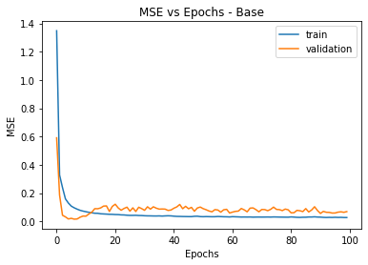
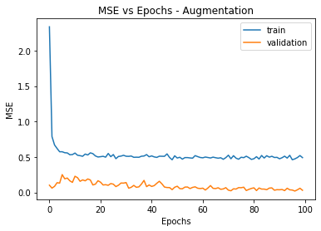
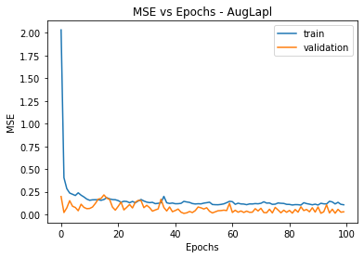
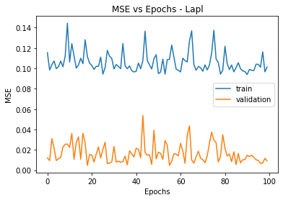
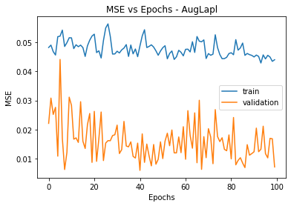
CONCLUSION

Slide 13
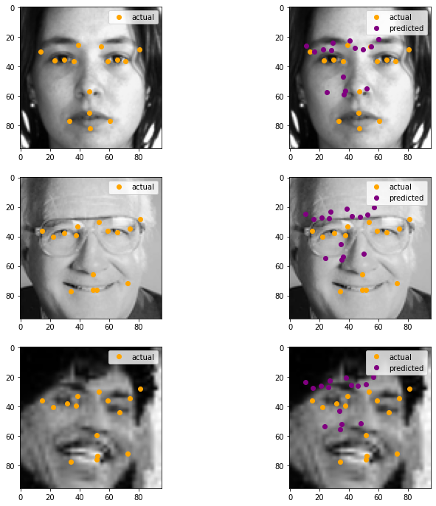
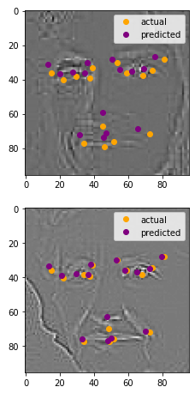
CONCLUSION
Baseline version
Augmentation version
Laplacian version

Slide 14
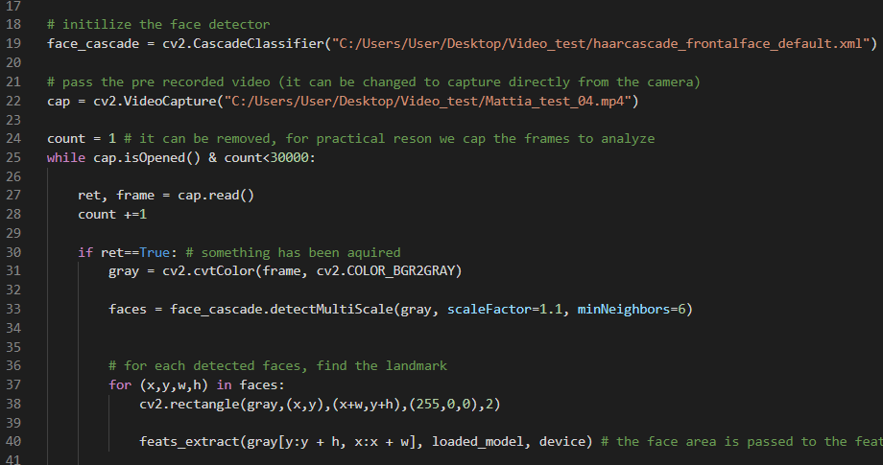
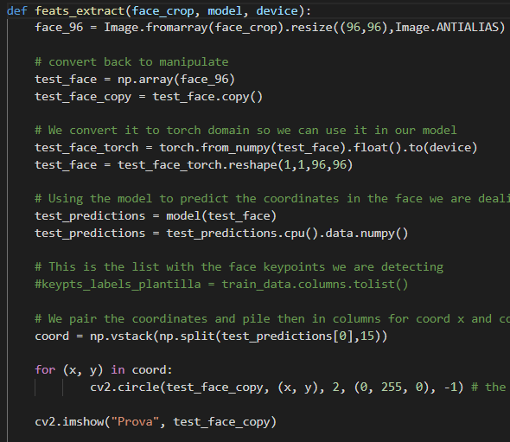
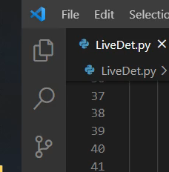
LIVE DETECTOR IMPLEMENTATION
premade face detector

Slide 15
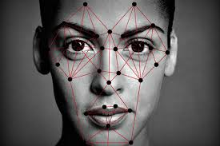
Future work
Refine the labelling of the original dataset
Implement a propretary feature extraction module
Project back the features locations on the original images

Slide 16

Q&A

Slide 17


Slide 18


